Slide 1

Generalizing Sentiment Analysis Techniques Across Sub-Categories of IMDB Movie Reviews
Nick Hathaway

Slide 2
Introduction
1.

Slide 3
Intro
Defining domains for Natural Language Processing
Sentiment Analysis and online movie reviews
Classify as positive or negative
Goal: create robust models

Slide 4
Background
Other review corpora:
Pang and Lee (2004)
Maas et. al (2011)

Slide 5
Research Question
1: How effectively will a sentiment classifier generalize at the level of movie genres?
2: Will some genres perform better or worse than their peers?

Slide 6
The Corpus
2.

Slide 7
IMDb
Launched in 1990
57th most visited site globally (Alexa rank)
Wiki-style editing
31.6% of visitors are from the U.S.

Slide 8
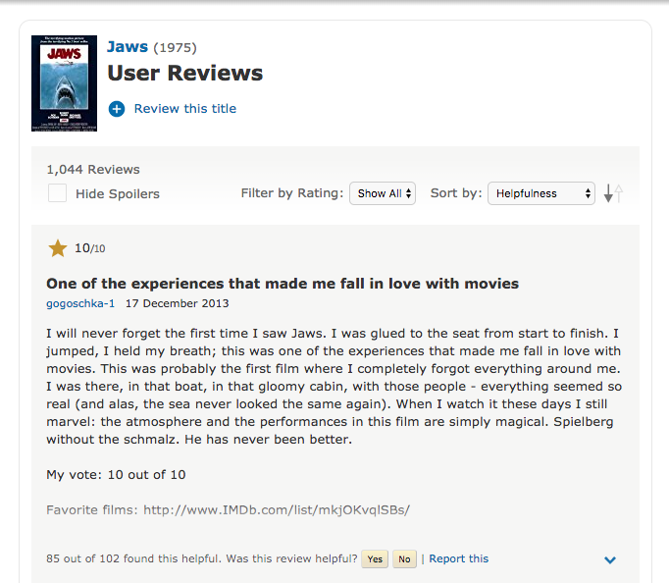
Example review

Slide 9
Building the Corpus
TMDb API
Titles by Genre
OMDb API
Title -> ID
IMDb
Scrape URL

Slide 10
Challenges
20,000 movie cap for TMDb API (per genre)
Dead URLs
Animation lost ~40% of total movie titles through the process

Slide 11
The Final Corpus
Genre | Class | Number Movies | Number of Reviews
Animation | Positive | 4,578 | 120,947
 | Negative | 2,628 | 34,751
 | Unrated | 2,977 | 32,889
Comedy | Positive | 9,855 | 252,001
 | Negative | 7,440 | 85,300
 | Unrated | 7,369 | 79,160
Documentary | Positive | 6,191 | 118,957
 | Negative | 3,049 | 35,475
 | Unrated | 3,611 | 32,469

Slide 12
The Final Corpus
Genre | Class | Number Movies | Number of Reviews
Horror | Positive | 7,164 | 203,467
 | Negative | 6,441 | 97,081
 | Unrated | 5,402 | 65,541
Romance | Positive | 8,394 | 222,517
 | Negative | 6,011 | 68,829
 | Unrated | 6,124 | 65,189
Positive: 917,889
Negative: 321,436
Unrated: 275,248

Slide 13
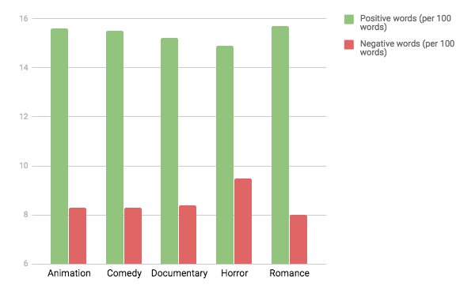
Polar word counts for positive reviews

Slide 14
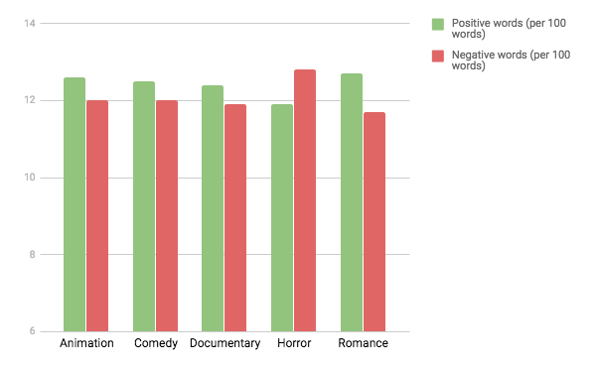
Polar word counts for negative reviews

Slide 15
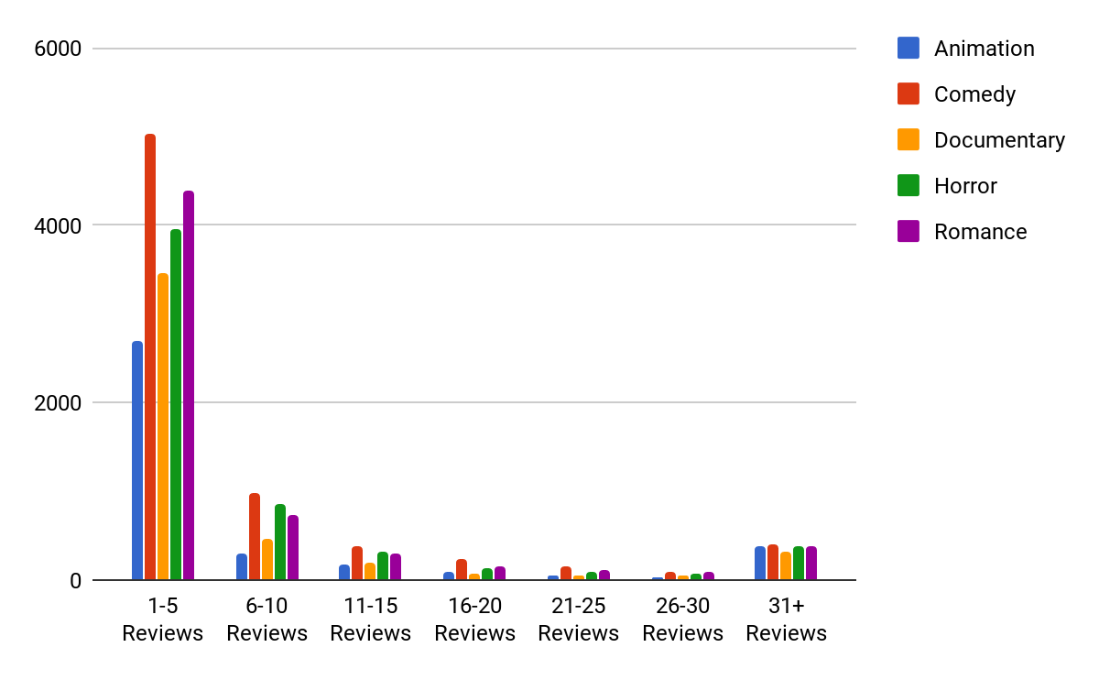
Number of titles by review contribution

Slide 16
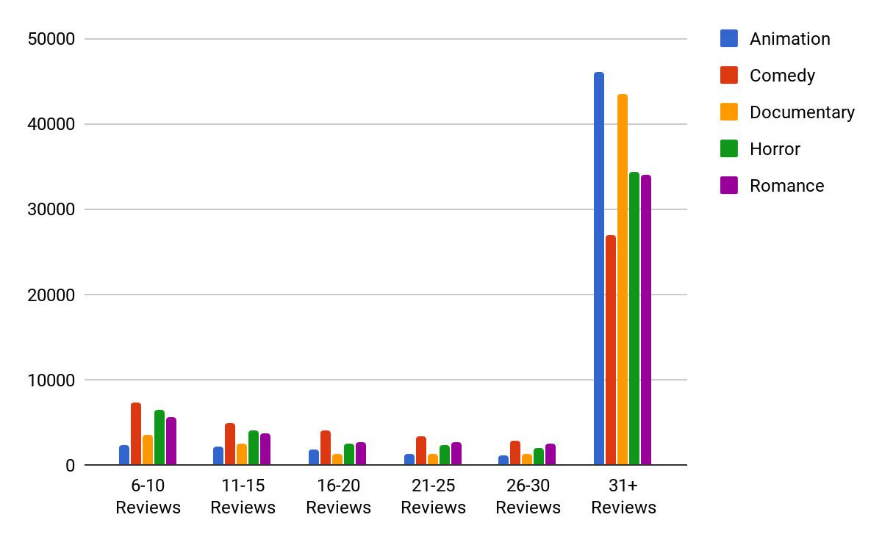
Number of total reviews by review contribution

Slide 17
Methodology
3.

Slide 18
Classifier
Linear Support Vector
Binary: predicts review as negative or positive
Text has been stemmed, stop words removed, references to rating deleted

Slide 19
Extracted Features
Unigram word counts (from top 500 most frequent)
Bigram counts (from 100 highest mutual info)
Percentage positive and negative words (Hu and Liu’s sentiment lexicon)
Positive: Negative word ratios

Slide 20
Train-Test Splits
Trained on mixed genres, tested on specific genre
Trained on specific genre, tested on mixed genres
Trained on four other genres, tested on specific genre
Trained on specific genres, tested on specific genres

Slide 21
Most informative features
Negative: worst, wast, aw, bore, terribl, unfortun, suppos, horribl, disappoint, poor
Positive: percent_pos_words, highli recommend, must see, edge seat, top notch, excel, one best, perfect, brilliant, hillari

Slide 22
Most informative features
Bigrams more often found as positive predictors
Only bigram in the top 20 for negative features was “wast time”
When trained on specific genres, actors and movie titles became more informative features

Slide 23
Results
4.

Slide 24
Overall Performance
For most genres, similar F-Scores (~83 to 86%)
Some changes in precision and recall (not significant)
One genre stood out: Horror

Slide 25
 | Animation | Comedy | Documentary | Horror | Romance
Animation |  | 85.46 | 85.29 | 85.10 | 85.22
Comedy | 85.17 |  | 85.09 | 85.00 | 85.10
Documentary | 84.53 | 84.50 |  | 84.00 | 84.41
Horror | 85.07 | 85.22 | 84.58 |  | 84.54
Romance | 85.48 | 85.52 | 85.23 | 85.00
Trained on specific genres, tested on specific genres

Slide 26
Horror
Trained on mixed
Positive reviews: higher precision, lower recall
Negative reviews: lower precision, higher recall
Trained on horror
Positive reviews: lower precision, higher recall
Negative reviews: higher precision, lower recall

Slide 27
Trained on all genres, tested on horror
Genre | Polarity | Precision | Recall | F-Score
Horror | Positive | 88.26 | 81.05 | 84.50
 | Negative | 82.48 | 89.22 | 85.72
Trained on other genres, tested on horror
Genre | Polarity | Precision | Recall | F-Score
Horror | Positive | 87.311 | 83.11 | 85.24
 | Negative | 83.91 | 88.10 | 85.96

Slide 28
Genre | Polarity | Precision | Recall | F-Score
Animation | Positive | 82.64 | 88.91 | 85.66
 | Negative | 88.00 | 81.32 | 84.53
Comedy | Positive | 82.79 | 88.38 | 85.50
 | Negative | 87.54 | 81.63 | 84.48
Documentary | Positive | 81.62 | 87.80 | 84.60
 | Negative | 86.80 | 80.23 | 83.39
Romance | Positive | 81.67 | 90.32 | 85.78
 | Negative | 89.17 | 79.72 | 84.18
Trained on horror, tested on specific genres

Slide 29
Overlapping Genres
Movies can have any number of genres
Concert recording: documentary, music
Stand-up routine: documentary, comedy
All genre tags given equal rating
Do multiple tags create a new genre or are the effects of the genres additive?

Slide 30
Conclusion
Sentiment generalizes well at the level of movie genres
Except for horror (differences in precision and recall)
Higher threshold of negative words required for negative classification
Other subdomains to consider?

Slide 31
Acknowledgements
Thank you to Bob Frank for your guidance and support and to Raffaella Zanuttini and the linguistics seniors for your company, feedback, and endless supply of bagels.

Slide 32
Credits
Presentation template by SlidesCarnival
Photographs by Unsplash

